Slide 1

Secure Voting System Through Face Recognition
by
Sai Pavani K
Roll No. 194G1A0572
Rohini M
Roll No. 194G1A0581
Susmitha CRG
Roll No. 194G1A05B3
Sai Preethi G
Roll No. 194G1A0586
Under the guidance of
Mrs. S. Sunitha, M.Tech(Ph.D)
Assistant Professor
Department of Computer Science and Engineering
Srinivasa Ramanujan Institute of Technology
Autonomous
Rotarypuram Village, B K Samudram Mandal, Ananthapuramu – 515701.
2022-2023

Slide 2
Review 2 Comments
Add Two-step verification at time of Voter Registration

Slide 3

Contents
Abstract
Introduction
Literature Survey
Existing System
Proposed System
Planning and Design
Implementation
Tentative Paper
Conclusion
References

Slide 4
Abstract
Now-a-days in India there are two types of methods are used for voting. The first method is secret ballot paper, in which lots of paper are used and second method is EVM(Electronic Voting Machine) which is used since 2003 but both of those methods have some limitations. There is a necessity for a method for online voting that is more secure than the existing system. In our proposed system we introduce a secure way for online voting by using face recognition system and email verification at the time registration of a new voter which is used to authenticate a person. Authorized Voter also can able to cast their vote only once and the tallying of the votes will be done automatically, thus saving a huge time and enabling administrator to announce the result to announce the result within a very short period.

Slide 5
Introduction
Machine learning is a subfield of artificial intelligence, which is broadly defined as the capability of a machine to imitate intelligent human behavior.
OpenCV is an open-source library for the computer vision. It provides the facility to the machine to recognize the faces or objects.
Local Binary Pattern (LBP) is a simple yet very efficient texture operator which labels the pixels of an image by thresholding the neighborhood of each pixel and considers the result as a binary number.
We have to know that in existing system is not much more secure because in existing system security level is only voter card so any one can give other person vote with voter card.
So, in this project voting system proposed in such a way that no one person can vote other person’s vote.
This can happen only by the face recognition of the voter. System checks that whether the voting person is correct or not.

Slide 6
Literature survey
Jehovah Jireh Arputhamoni and Gnana Saravanan[1], have proposed that different biometrics they are Iris Detection in Voting System, Voting System using Fingerprint Recognition, Smart Voting.
This proposed concept is entirely web-based system so the basic features related are web-based technologies such as database creation, image processing properties which determine the software requirement of the system.
The voter’s face and fingerprints will be captured with help of laptop, PC Or mobile camera. The captured image can be detected using Haar Cascade algorithm and fingerprints can compared with image stored in database using CNN.
The CNN algorithm used makes the system unique and efficient. It makes sure that the voter is validated before the voting process.
The designed system is also less time-consuming, in expensive and hassle-free way of conducting the election process, making smart voting a better way to vote.
Instead of having two biometrics we can have one biometric authentication with same security level.

Slide 7
Literature survey
Aman Kumar and Vishwash Kumar[2], have clearly explained about three different-different working security levels in smart voting system.
At level 1 Unique Id Number (UID), at the time registration system will request for the one unique id from the user. So through the unique id verification from database the voter can enter to next security level.
At level 2 Election Commission id card number, here the voter has to enter voter’s id number and it is going to verified from the database.
At level 3 Face Recognition with respective voter’s id number, if the voter’s face is matched with the stored image in database then voter can cast their vote.
Every new user in the India is first register for voting. At the time registration System Capture the face of the user and store the Face sample in the server database.
More Convenient, No Corruption, Safter and faster are the advantages to this security levels. So we opted this security levels but differ in the algorithm used for face recognition.

Slide 8
Literature survey
Nilam Choudary, Shikar Agarwal and Geerija Lavania[3], have proposed a smart voting system through face recognition in 3 types of algorithms.
Eigenfaces uses eigenvectors for performing facial recognition and for finding eigen values uses Principal Component Analysis (PCA)
PCA is method for dimensionality reduction and creates eigen space by reduction of common attributes.
Fisher faces is extension to the eigenface technique. Along with PCA it uses Linear Discriminant Analysis (LDA) which helps in finding directions that are used for classification.
Speed Up Robust Features (SURF) helps in similarity invariant representation and rapid comparison images.
In this research Paper, on training data set consists of 2316 images and also having 4 more samples per image which gives total 9264 images.
Future work is applying important techniques like CNN… on large training data sets.

Slide 9
Literature survey
XueMei Zhao, ChengBing Wei[4], The Local Binary Pattern Histogram(LBPH) algorithm is a simple solution on face recognition problem, which can recognize both front face and side face. A modified LBPH algorithm based on pixel neighborhood gray median(MLBPH) is proposed.
The gray value of the pixel is replaced by the median value of its neighborhood sampling value, and then the feature value is extracted by the sub blocks and the statistical histogram is established to form the MLBPH feature dictionary, which is used to recognize the human face identity compared with test image.
OpenCV is an open source computer vision library that has three built-in face recognition algorithms, Eigenfaces, Fisherfaces and Local Binary Pattern Histogram (LBPH).
Compared with the other two algorithms, the LBPH algorithm can not only recognize the front face, but also recognize the side face, which is more flexible.
Face recognition system includes four main parts: information acquisition module, feature extraction module, classification module and training classifier database module.
In the classification module, the classifier trained by database is used to classify the test samples to determine the identity information of the samples. OpenCV provides a Haar cascade classifier, which can be used for face detection. The LBPH algorithm uses the histogram of LBP characteristic spectrum as the feature vector for classification.

Slide 10
Literature survey
Shubham Shinde, Manas Shende, Jeet Shah, Harshdeep Shelar[5]This proposed project is a client-server software architecture. According to our system, a person needs to first register with his fingerprint and face image
The information related to voters, candidates, constituencies, and votes are stored in the Google Firebase Real-time Database.
At the client-side, there will be a fingerprint device that will take the fingerprint of the voter, and a GUI which will take the login details and capture the face image of the voter.
The whole process of face recognition is divided into 4 following parts: 1. Detecting faces in Image 2. Isolating and projecting faces 3. Face Encoding 4. Face identification
Faces in the image can be detectedusingHOG (Histogram of Oriented Gradients). The next step is to warp the faces including eyes, lips, etc perfectly in the frame. Aligning faces accurately during both training and testing gives a boost in performance.
The last step is to identify the person from our database who has the closest measurement with the test image provided. The classification of the image is done using KNN (k-nearest neighbour) classifier

Slide 11
Existing System
In the Existing System, they are working with three different security levels where level 1 is Unique id number, level 2 is Election commission id card number and level 3 is Face Recognition.
A new user has to register by entering their details, at this time system is going to capture the face of an user and those are stored in the database.
If an user details is existing in the database then directly user will login and cast their vote after finishing the three levels of authentication.
In this eigen face algorithm is used which is used to capture the variation in a collection of face images and this information is use to encode the particular images of individual images.
And few of them added two biometric authentications for casting a vote.

Slide 12
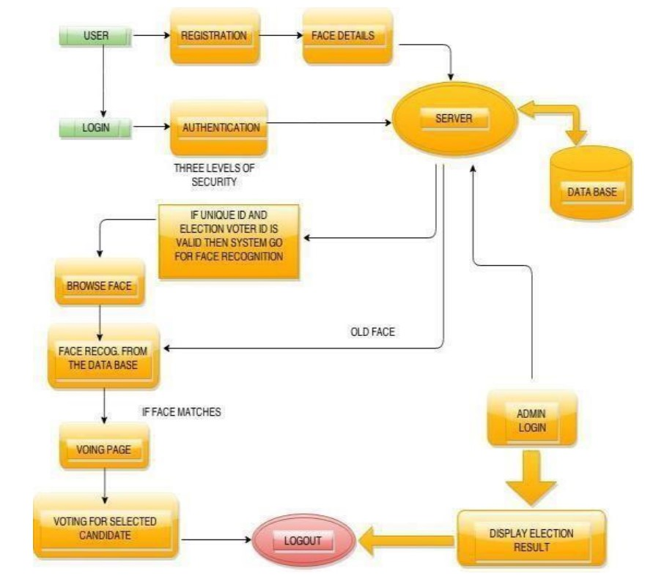
Existing System

Slide 13
Existing System
Algorithm:
Eigen Face Algorithm
Gabor Filter is used and its consists of 40 filters used to detect the faces from the captured image.
Disadvantages-
Unauthorized person can register by filling authorized details.

Slide 14
Proposed System
In our proposed system we are using two levels of hierarchial approach for developing a secure online voting interface at college level.
In the first level we are generating unique id for every student.
In the second level they will be verified using face recognition techniques.
The server aspects of the proposed system have such distribution of authority that server does not enable to manipulate the votes.
In this system we are ensuring that each user can cast their vote only once by including verification through email.
The system provides a user-friendly web interface for the administrators to manage the system, view the results, and generate reports and also for the users to caste their vote.

Slide 15
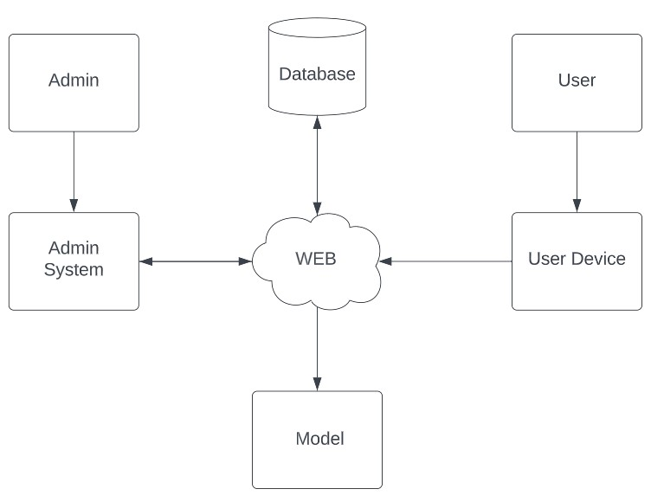
Proposed System
System Architecture

Slide 16
Planning
Objectives:
To Propose a system that will make an user to vote at anywhere and can reduce fake votes through face recognition authentication.
Some other objects of achieving in this are mentioned below:
Scope:
Reduce the fake votes by validating an user through face recognition at college level.
An User can cast their vote, only if the user details already existed in database.
The system does not allow same voter to cast their vote for multiple times.
Performance:
The Performance of the project is efficient by the following:
LBPH is one of the easiest face recognition algorithms. It can represent local features in the images. It is possible to get great results (mainly in a controlled environment). It is robust against monotonic gray scale transformations. It is provided by the OpenCV library (Open Source Computer Vision Library).

Slide 17
Planning
Time Estimate:
Basically, our project is divided into two phases.
Phase – 1: Pre-requisites, Planning and Designing.
S.No | Activity | Duration
1 | Domain Selection | 1 week
2 | Literature Survey and Problem Definition | 2 weeks
3 | Planning and Designing | 3 weeks

Slide 18
Planning
Phase – 2: Developing the model
S.No | Activity | Duration
1 | Data Collection and Data Pre-Processing | 1 week
2 | Developing Code | 3 weeks
3 | Building Classifier Model | 2 weeks
4 | Validating and Comparing models | 2 weeks

Slide 19
Planning
Requirement Specification
SOFTWARE REQUIREMENS
Operating System : Windows 7+
GUI : Flask
IDE : PyCharm IDE
Libraries Used : Pandas, os, Pillow, pymysql, numpy.
HARDWARE REQUIREMENTS
Processor - I3/Intel Processor
RAM - 4GB (min)
Hard Disk - 128 GB
Key Board - Standard Windows Keyboard

Slide 20
Planning
Functional Requirements
To provide an authentication by capturing the face and comparing it with the existing face in database.
To allow an user for casting a vote only once by comparing the user details with casted members database.
To provide an alert to the user by providing a message when an authorized user is going to login for casting a vote.
Non Functional Requirements
Integrity
This Project allows only authorized persons for casting a vote through Face Recognition.
Security
This Project provides security to the database by which it can be accessed by admin.
Usability
This project can be used in voting systems in order to reduce fake votes and provide a web page to cast a vote at any place.

Slide 21
Design
MODULES-
USER: User is the person who is interested to vote we can call him as an voter.
User Register: Register into the system if he is new otherwise he log’s in directly.
User Login: Login into the system using facial images.
User vote: They vote to their desired candidate.
Logout: After voting they logout from the application.

Slide 22
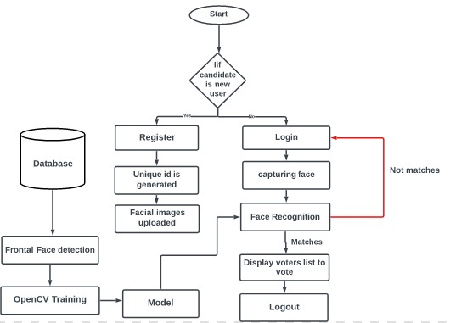
Design
Workflow of an User

Slide 23
Design
ADMIN:
Admin is the person in charge and maintaining the system entirely.
The main functions of the admin are:
Login: Logs into the system.
Select Candidates: Selects the candidates for voting.
View: View voting results.
Logout: after completing the process he log’s out from the system.

Slide 24
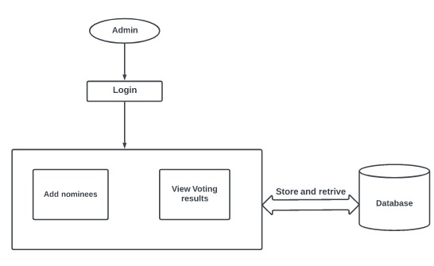
Design
Workflow of an admin

Slide 25
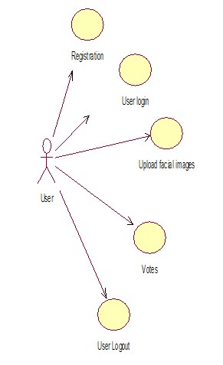
Design
Use case Diagram for an User

Slide 26
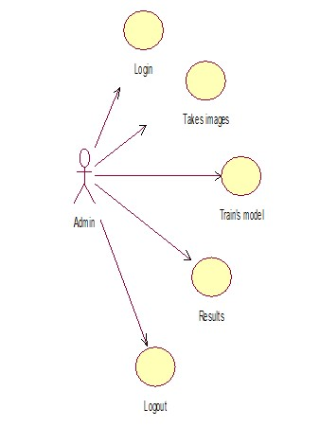
Design
Use case Diagram for an Admin

Slide 27
Implementation
Frontend: Web page using HTML, CSS, Bootstrap
Backend: Using OpenCV and LBPH algorithm
Libraries used:
NumPy: NumPy library is an important foundational tool for Machine Learning. Many of its functions are very useful for performing any mathematical or scientific calculation operations.
Padas: Pandas is a python library used for working with data sets. It has functions for analyzing, Cleaning, exploring and manipulating data.
Pymysql: PyMySQL is a pure-Python MySQL client library, which means it is a Python package that creates an API interface for us to access MySQL relational databases.
Requests: The most famous http library written by Kenneth remits. It’s a must have for every python developer.
Pillow: A friendly fork of PIL (Python Imaging Library). It is more user friendly than PIL and is a must have for anyone who works with images.

Slide 28
Contd…
Beautiful Soup: I know it’s slow but this xml and html parsing library is very useful for beginners.
Smtplib: The smtplib module defines an SMTP client session object that can be used to send mail to any internet machine with an SMTP or ESMTP listener daemon.
os: The os module in python provides functions for interacting with the operating system. os comes under python’s standard utility modules. This module provides a portable way of using operating system-dependent functionality.
Matplotlib: A numerical plotting library. It is very useful for any data scientist or any data analyzer.
cv2: cv2 isan open-source python library, which used to understand the content of the digital image. It extracts the description from the real-time image or digital image, which may be an object, a text description, and so on.
flash(): this method is used to generate informative messages in the flask. It creates a message in one view and renders it to a template view function called next.

Slide 29
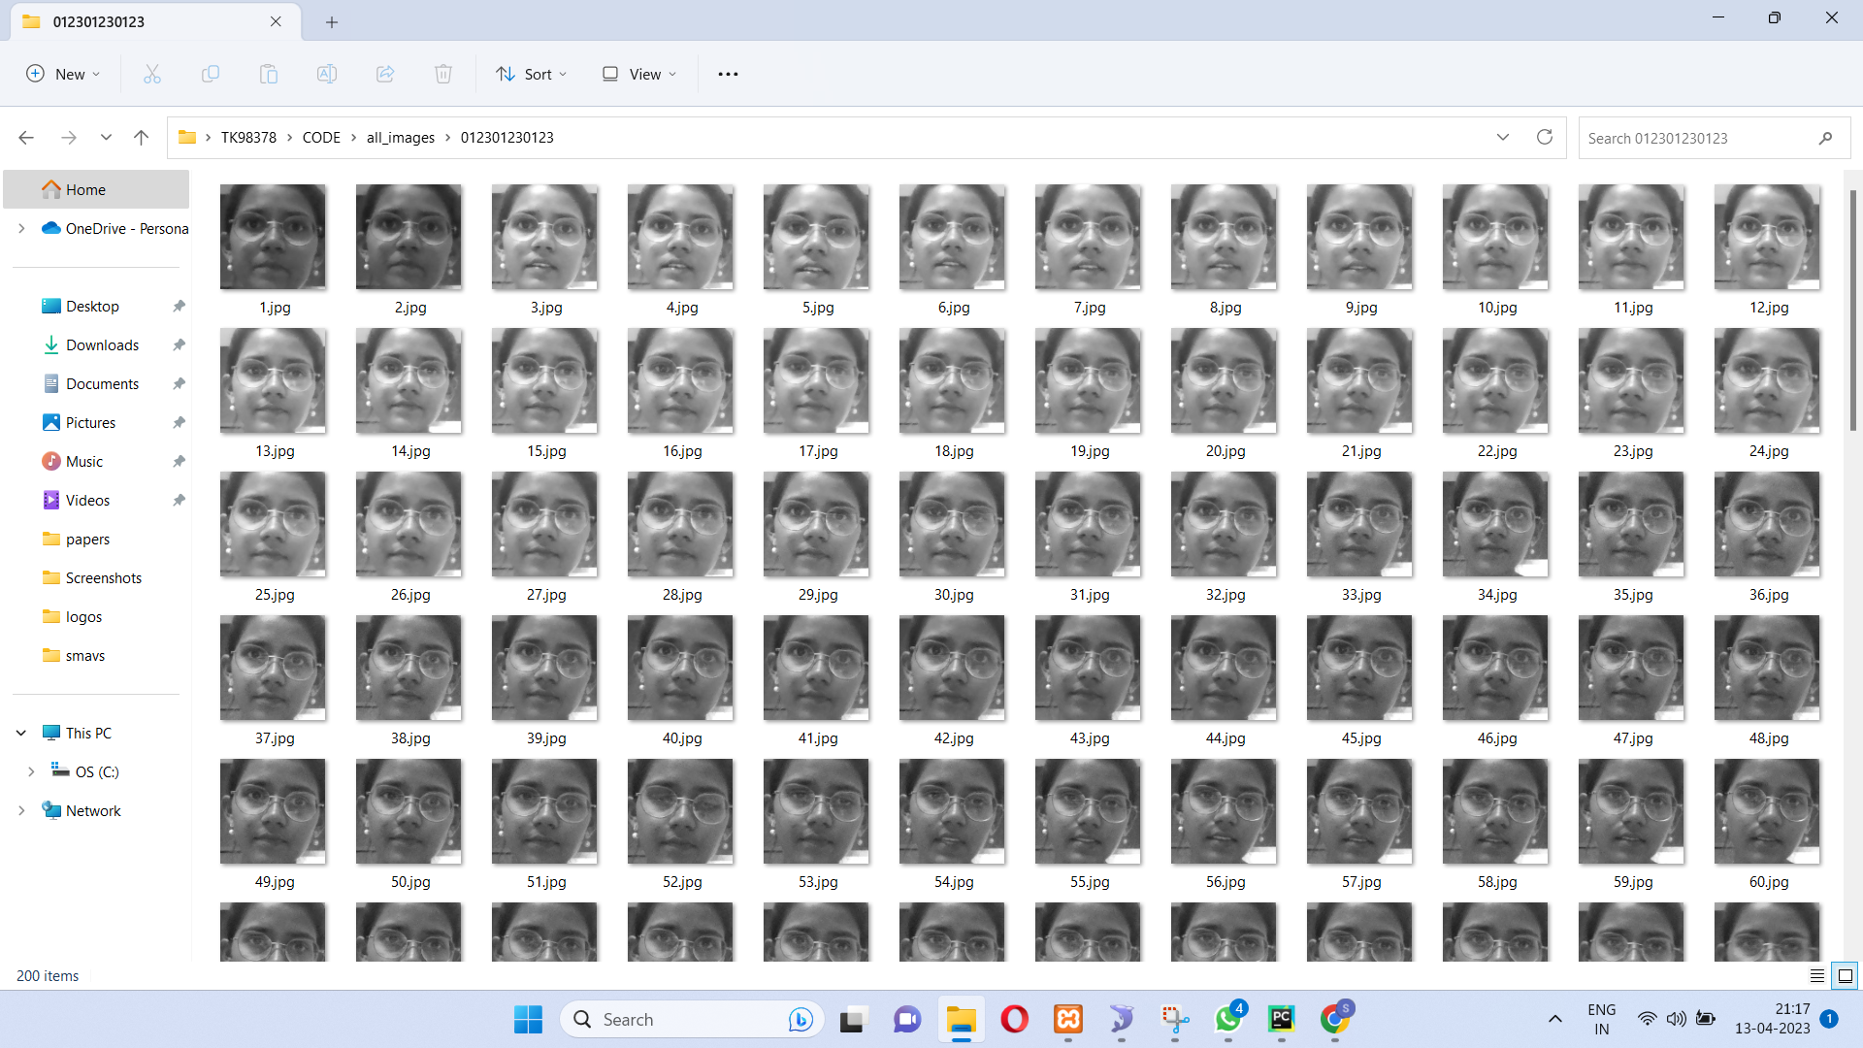
Contd…
Captured Images at the time of Registration

Slide 30
Contd…
Local Binary Patterns Histograms
LBPH is an excellent feature for the classification of certain textures like faces. It requires four distinct parameters to process an image, they are radius (r), neighbors (n), X-axis and Y-axis. Here X and Y-axis represents the dimensionality of the features grid in vertical and horizontal manner. The first step is to train the algorithm, and to do so, it is necessary to use correct dataset with facial images of the people that we need to identify. For the computational step, it is imperative to transform an image of a person into set of 3×3 macro-block for better representation. By doing this, it is possible to pin point each and every feature that exist on a person’s face. Each macro-block have 9 pixels and they have the range of 0 to 255 as they are of grayscale format.

Slide 31
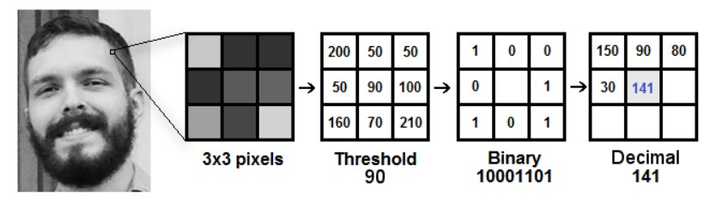
Contd…
Internal Workflow of LBPH Algorithm

Slide 32
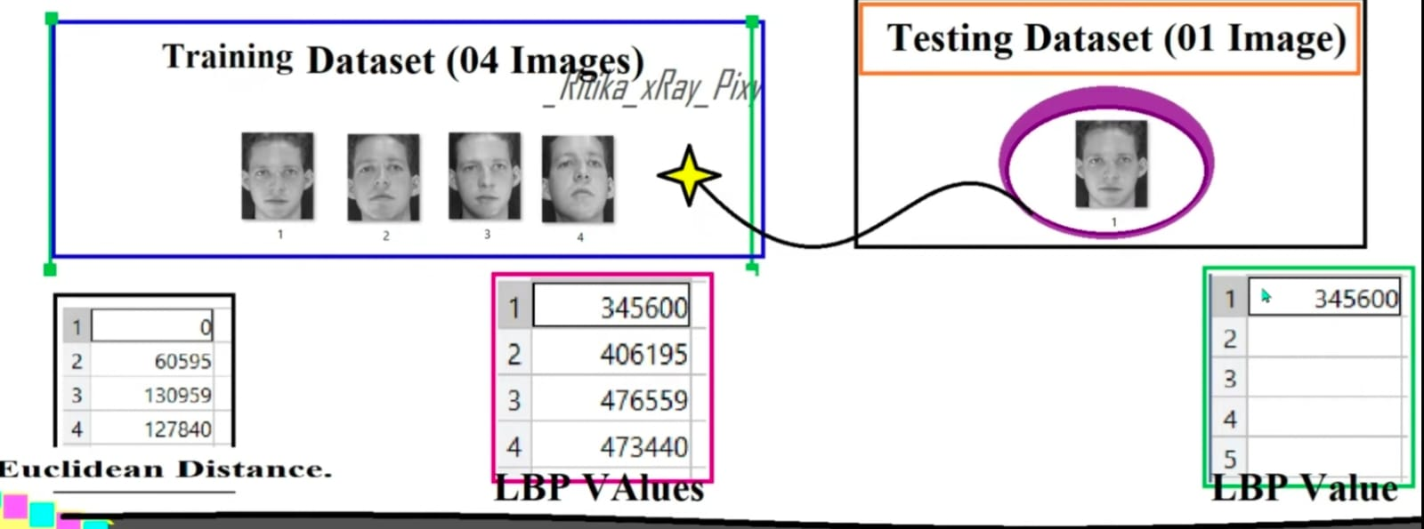
Contd…
Comparing of LBP Values of Test Data with Training Data

Slide 33
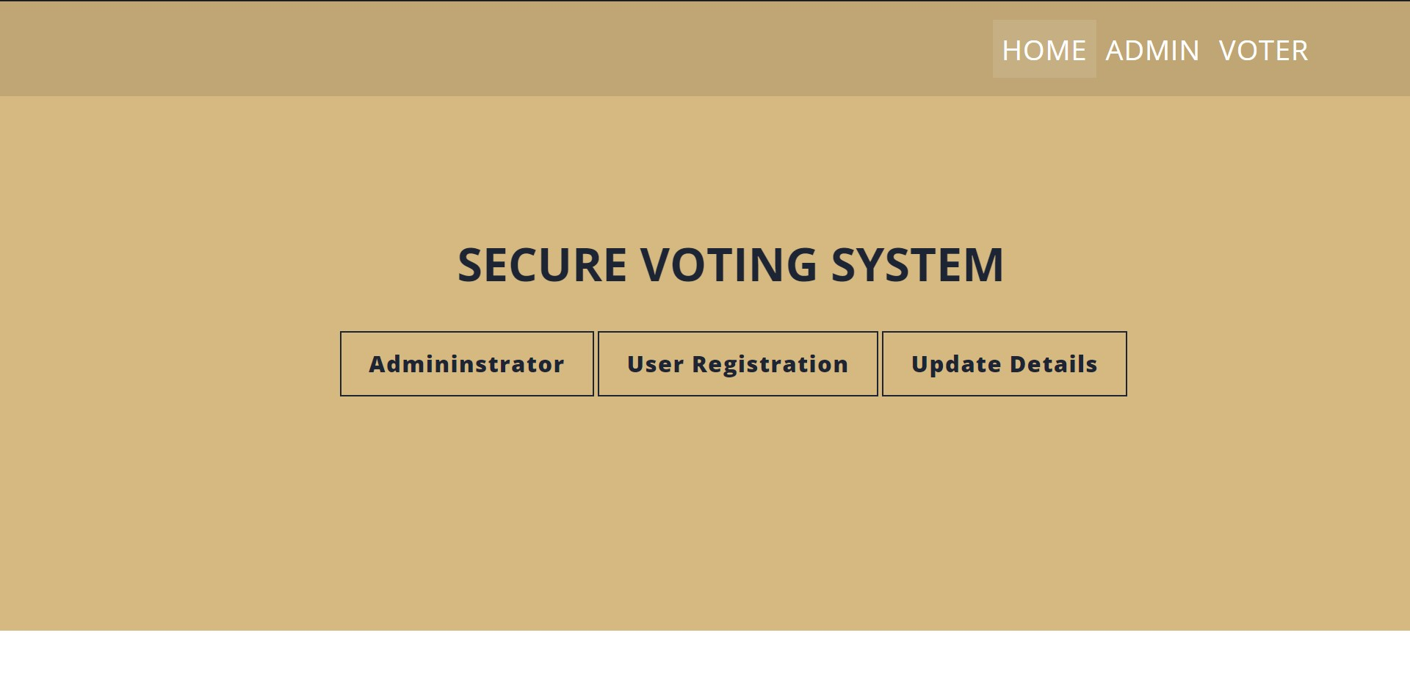
Contd…
Home Page

Slide 34
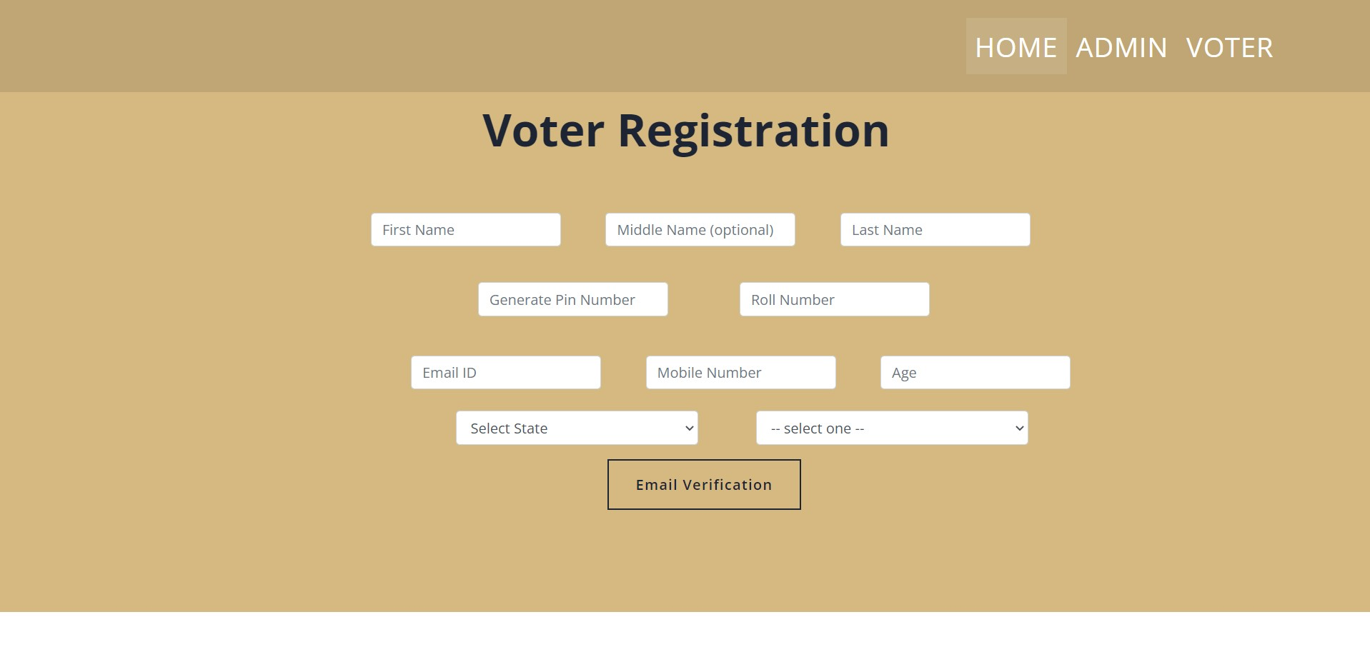
Contd…
Voter Registration Page

Slide 35
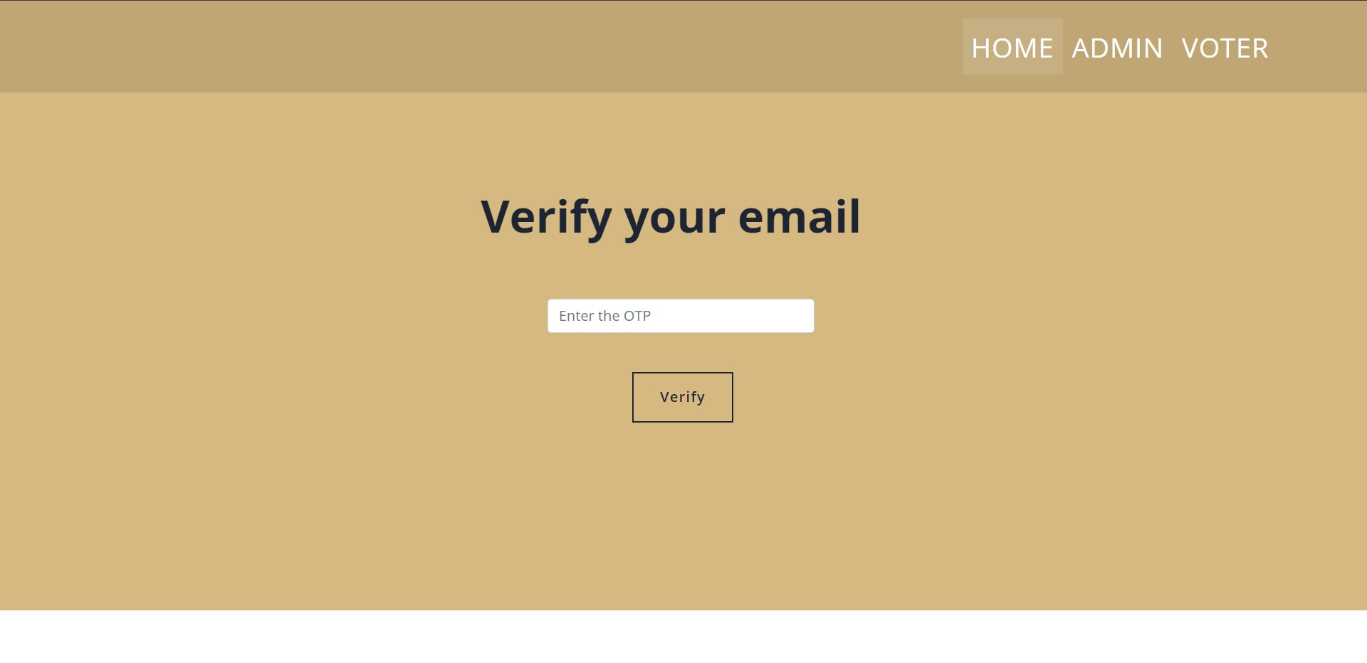
Contd…
Email Verification After Voter Registration

Slide 36
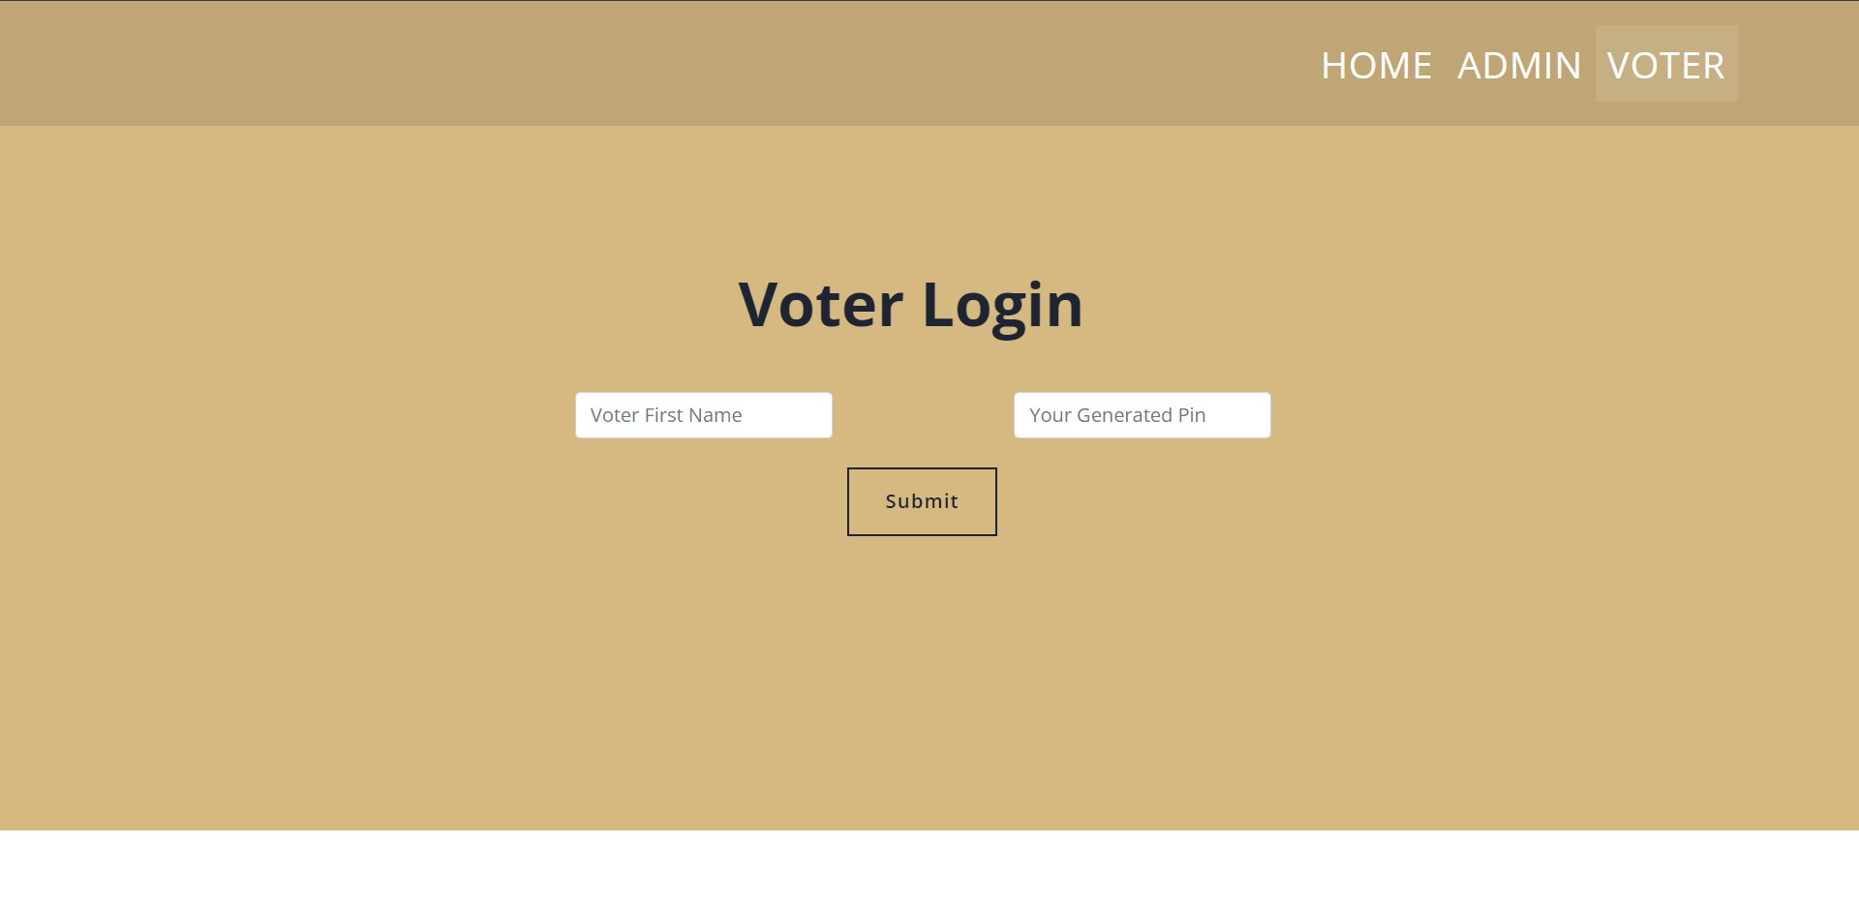
Contd…
Voter Login Page

Slide 37
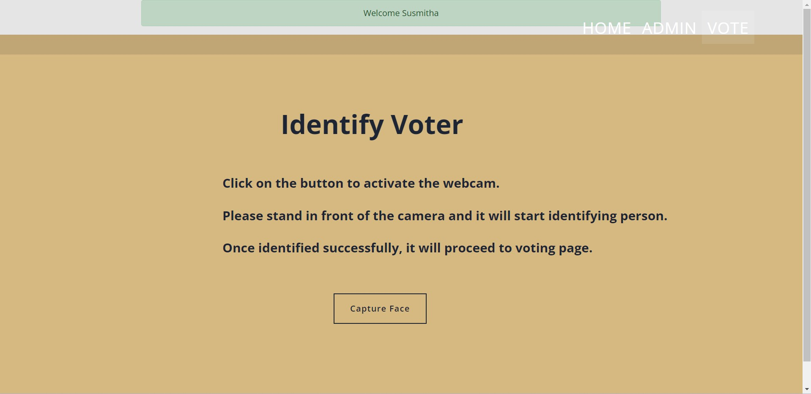
Contd…
Verifying the Voter at the time of LOgin

Slide 38

Contd…
Admin Login Page

Slide 39

Contd…
Admin Dashboard

Slide 40
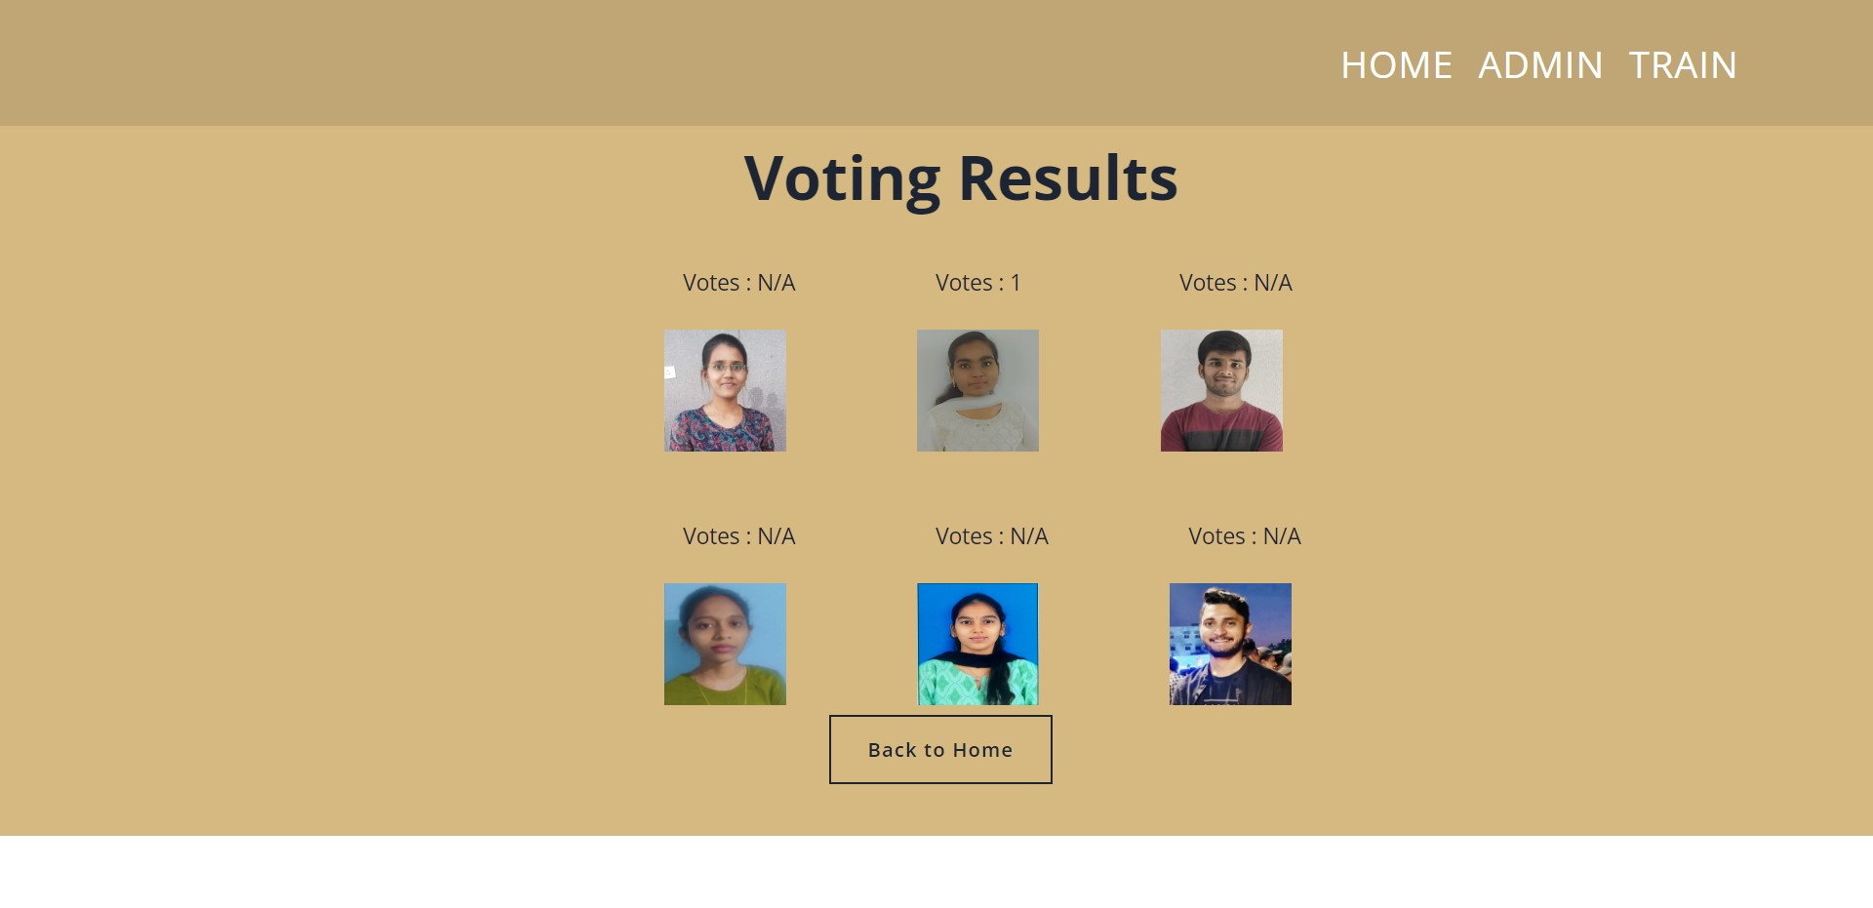
Contd…
Voting Results Page at Admin Dashboard

Slide 41
Research Paper
Research Paper

Slide 42
Conclusion
As we can see, the current voting system has numerous flaws, including a long process that takes a lot of time, is not safe, allows for fake voting, and has no security level. The proposed method can address the issues and limitations of the current system, which will ultimately reduce bogus and false votes. This is because its difficult for the hackers to do marphing the face in live and offers a secure and comfortable voting environment. Using this method, voters can cast their ballots at the closest polling place or even from home if they are familiar with how the technology operates and understand its fundamentals. In our proposed system we are developing a user friendly web interface where users can easily interact with it to vote.

Slide 43
References
[1]. Jehovah Jireh Arputhamoni and Gnana Saravanan “Online Smart Voting System Using Biometrics Based Facial and Fingerprint Detection on Image Processing and CNN”, Third International Conference on Intelligent Communication Technologies and Virtual Mobile Networks (ICICV) IEEE-2021.
[2]. Aman Kumar and Vishwash Kumar, “Smart Voting System Through Face Recognition”, in 2019 Accelerating the world’s research(ACADEMIA).
[3]. Nilam Choudary, Shikar Agarwal and Geerija Lavania, “Smart Voting System through Facial Recognition”, International Journal of Scientific Research in Computer Science and Engineering, April 2019.
[4]. XueMei Zhao, ChengBing Wei, “A Real-time Face Recognition System Based on the Improved LBPH Algorithm”, 2017 IEEE 2nd International Conference on Signal and Image Processing
[5]. Shubham Shinde, Manas Shende, Jeet Shah, Harshdeep Shelar,” An Approach for e-Voting using Face and Fingerprint Verification”, 2020 IEEE Pune Section International Conference (PuneCon)

Slide 44
Thank You!!!

